Slide 1
Data Machines Interview
Jason Shenny

Slide 2
Agenda
Personal Background
Professional Career, Academia, Interests
Image Classification Project
Code analysis (Python)
Product fault data mining & analysis
Questions

Slide 3

Jason Shenny in 100 Words or Less
Propulsion Systems Analyst
Component level trades (Aero / thermo / fluids)
Engine functionality, performance, control, requirements
Fleet trending, statistical analysis, data mining, machine learning
Academia
Graduate (M.Sc.): University of Washington, Applied Mathematics
Computation Methods of Data Analysis
Clustering, Classification, Reduced Order Modeling, Time Series, Image Analysis, Linear Algebra
High Performance Computing (C++, OpenMP, GPU, SPMD)
Data Access & Analysis (SQL, R, VBA, VB.Net)
Probability & Random Processes (Poisson, Branching, Characteristic Functions, Stochastics)
Undergraduate (B.Sc.): Penn State, Mechanical Engineering
Interests & Hobbies
Artificial Intelligence
Education (AI for Anyone)
Professional and Collegiate Sports
Stock trading
Traveling, hiking, skiing

Slide 4
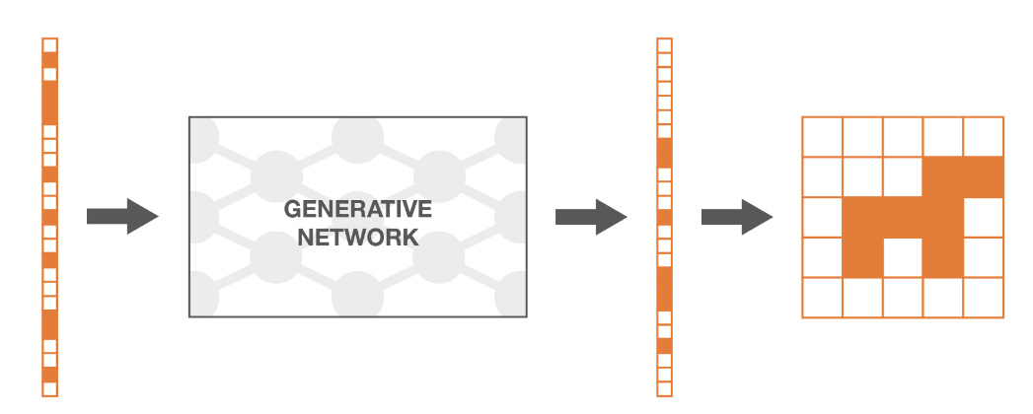
Computational Data Analysis Project
Problem Statement
Develop an algorithm to classify images created by a GAN vs real photos
GAN: Generative Adversarial Network
Modeling Methodology
Classification algorithms:
Logistic Regression
Naïve Bayes
SVM
Decision Tree
AdaBoost
Preprocessing & Dimensionality Reduction Techniques
Fast Fourier Transform (FFT)
Singular Value Decomposition (SVD)

Slide 5


Who can you guess which face belongs to a human and which belongs to an algorithm?
GAN
REAL

Slide 6
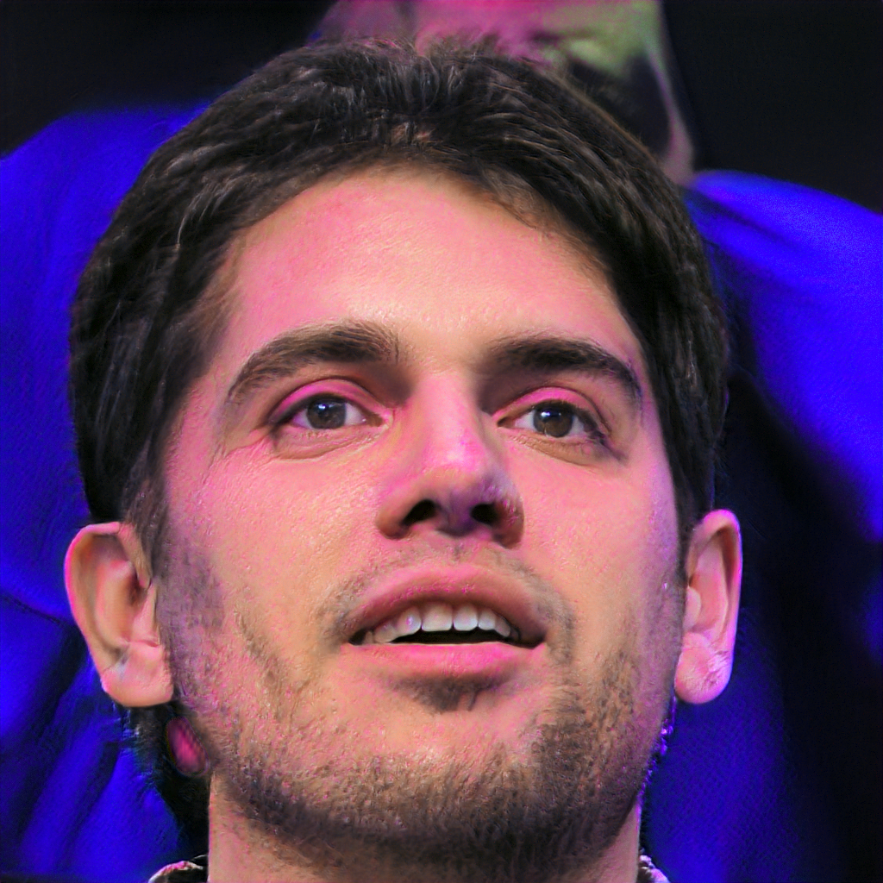

Can you tell which one has a soul and which one has a neural network?
GAN
REAL

Slide 7


Where…when can we draw the line between what is real and what is fake?
REAL
GAN

Slide 8
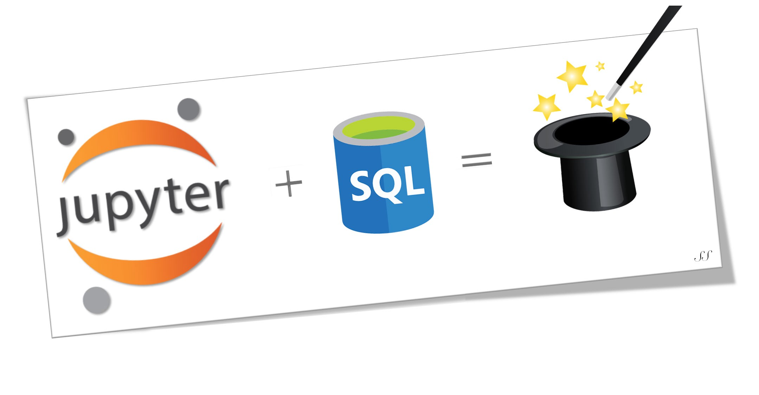
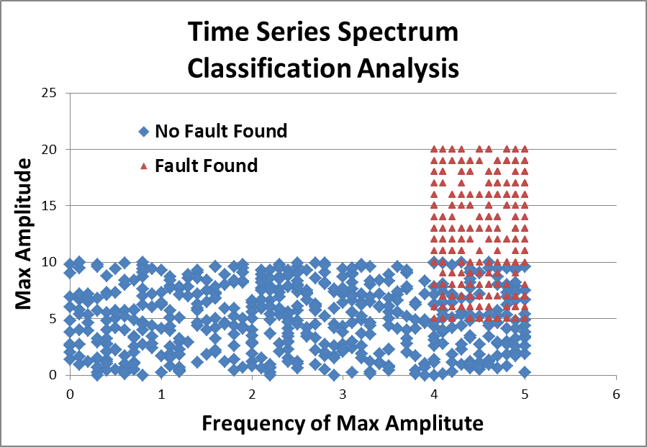


Product Fault Data Mining & Analysis
Reduced number of engines to visualize by >90%
~2000 Engines Processed through algorithm
METADATA
UNPACK
ALGORITHM
15 engines successfully identified with faulty condition
Automated capability to identify future fault engines

Slide 9
Questions?

